Slide 1
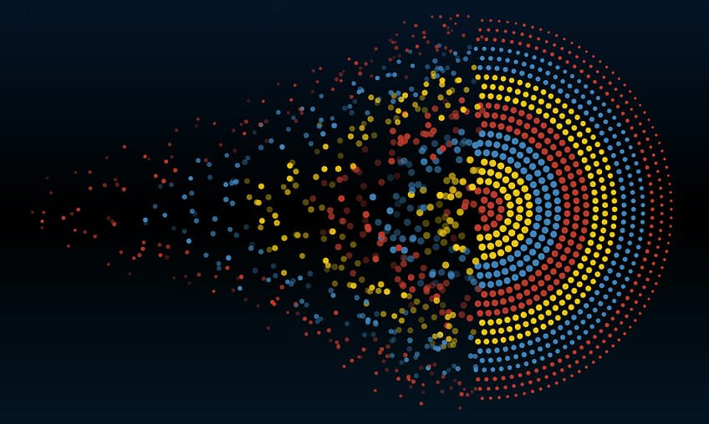
Data Visualization
Lecture 5
11/3/2022

Slide 2
Data Pre-processing
Data pre-processing, a component of data preparation, describes any type of processing performed on raw data to prepare it for another data processing procedure.
It has traditionally been an important preliminary step for the data mining process. More recently, data pre-processing techniques have been adapted for training machine learning models and AI models and for running inferences against them.

Slide 3
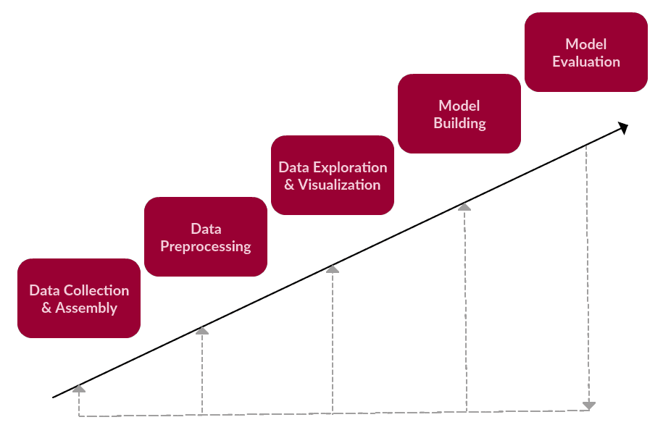
Processing the Data

Slide 4
Methods for Pre-Processing
There are several different tools and methods used for pre-processing data, including the following:
Sampling: which selects a representative subset from a large population of data;
Transformation: which manipulates raw data to produce a single input;

Slide 5
Contd.
Denoising: which removes noise from data
Imputation: which synthesizes statistically relevant data for missing values;
Normalization: which organizes data for more efficient access; and
Feature extraction: which pulls out a relevant feature subset that is significant in a particular context.

Slide 6
Opinion on Data Pre-processing
In most circumstances, it is preferable to view the original raw data.
In many domains, such as medical imaging, the data analyst is often opposed to any sort of data modification process, such as filtering or smoothing, for fear that important information will be lost or deceptive artifacts will be added.

Slide 7
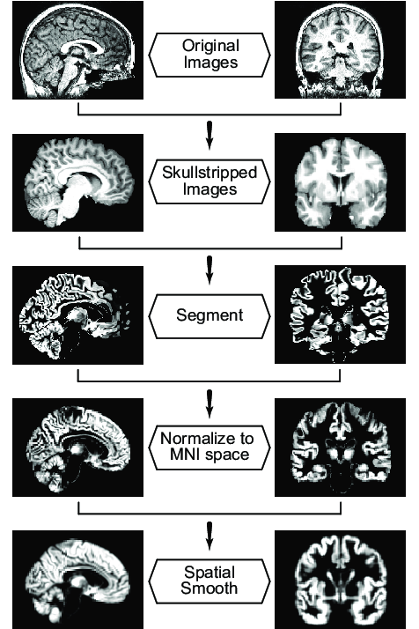
Problem with Data Pre-Processing

Slide 8
Contd.
Viewing raw data also often identifies problems in the data set, such as missing data, or outliers that may be the result of errors in computation or input.
Depending on the type of data and the visualization techniques to be applied, however, some forms of pre-processing might be necessary.

Slide 9
Metadata & Statistics
Information regarding a data set of interest (its metadata) and statistical analysis can provide invaluable guidance in pre-processing the data.
Metadata may provide information that can help in its interpretation, such as the format of individual fields within the data records.

Slide 10
Contd.
It may also contain the base reference point from which some of the data fields are measured, the units used in the measurements, the symbol or number used to indicate a missing value (see below), and the resolution at which measurements were acquired.
This information may be important in selecting the appropriate pre-processing operations, and in setting their parameters.

Slide 11
Contd.
Various methods of statistical analysis can provide us with useful insights.
Outlier detection can indicate records with erroneous data fields.
Cluster analysis can help segment the data into groups exhibiting strong similarities.
Correlation analysis can help users eliminate redundant fields or highlight associations between dimensions that might not have been apparent otherwise

Slide 12
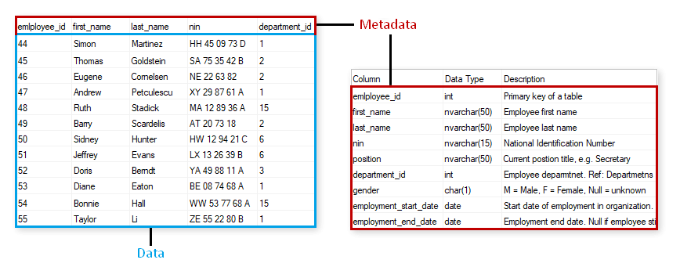
Meta Data Example

Slide 13
Central Tendency through Mean, Median, Mode
The mean is the arithmetic average of a set of given numbers.
The median is the middle score in a set of given numbers.
The mode is the most frequently occurring score in a set of given numbers.

Slide 14
Mean
The mean, or average, is calculated by adding up the scores and dividing the total by the number of scores. Consider the following number set: 3, 4, 6, 6, 8, 9, 11. The mean is calculated in the following manner:
3 + 4 + 6 + 6 + 8 + 9 + 11 = 47
47 / 7 = 6.7
The mean (average) of the number set is 6.7.

Slide 15
Median
The median is the middle score of a distribution.
To calculate the median
Arrange your numbers in numerical order.
Count how many numbers you have.
If you have an odd number, divide by 2 and round up to get the position of the median number.
If you have an even number, divide by 2. Go to the number in that position and average it with the number in the next higher position to get the median.

Slide 16
Contd.
Consider this set of numbers: 5, 7, 9, 9, 11. Since you have an odd number of scores, the median would be 9.
You have five numbers, so you divide 5 by 2 to get 2.5, and round up to 3.
The number in the third position is the median.
What happens when you have an even number of scores so there is no single middle score? Consider this set of numbers: 1, 2, 2, 4, 5, 7. Since there is an even number of scores, you need to take the average of the middle two scores, calculating their mean.

Slide 17
Mode
Since the mode is the most frequently occurring score in a distribution, simply select the most common score as your mode.
Consider the following number distribution of 2, 3, 6, 3, 7, 5, 1, 2, 3, 9.
In some number sets, there may actually be two modes. This is known as bi-modal distribution and it occurs when there are two numbers that are tied in frequency. For example, consider the following set of numbers: 13, 17, 20, 20, 21, 23, 23, 26, 29, 30. In this set, both 20 and 23 occur twice.
If no number in a set occurs more than once, then there is no mode for that set of data.

Slide 18
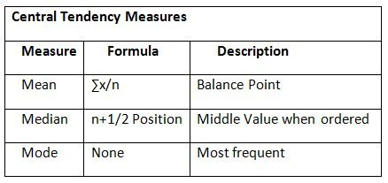
Re-cap

Slide 19
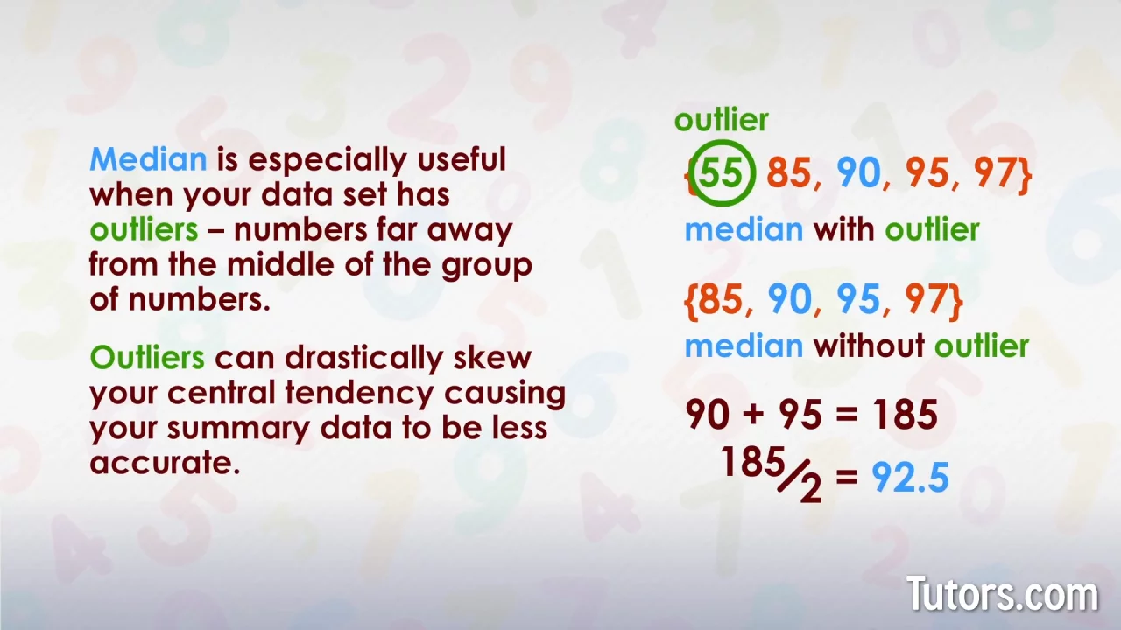
Median with Outlier

Slide 20
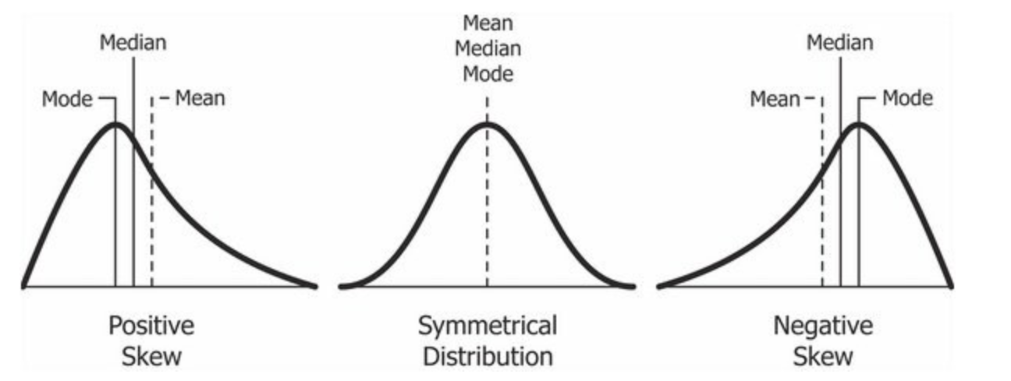
Distribution of Mean-Median-Mode

